Slide 1


Pandas resample and apply method

Slide 2
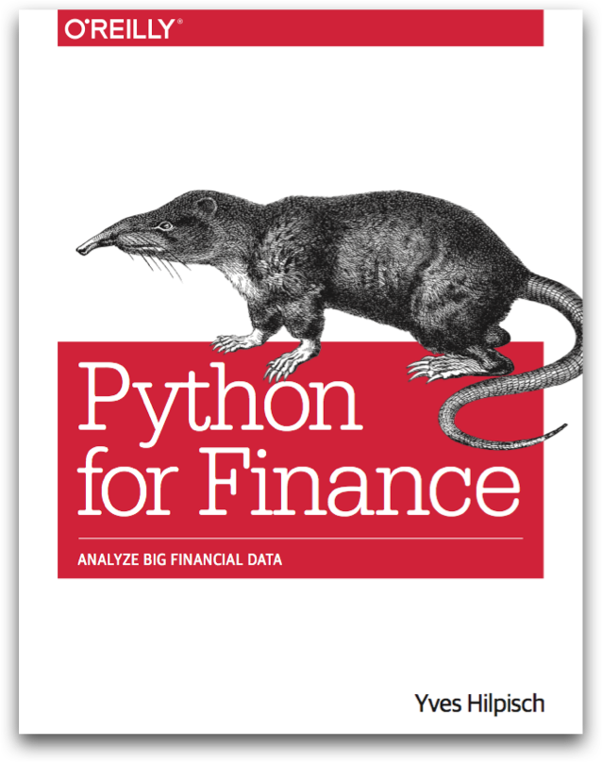
Reference
Chapter 6 of Python for Finance (O'Reilly)
Youtube
Code

Slide 3
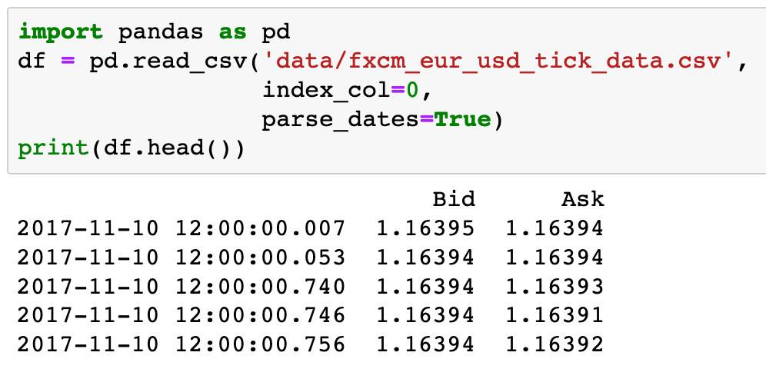

Slide 4


Slide 5
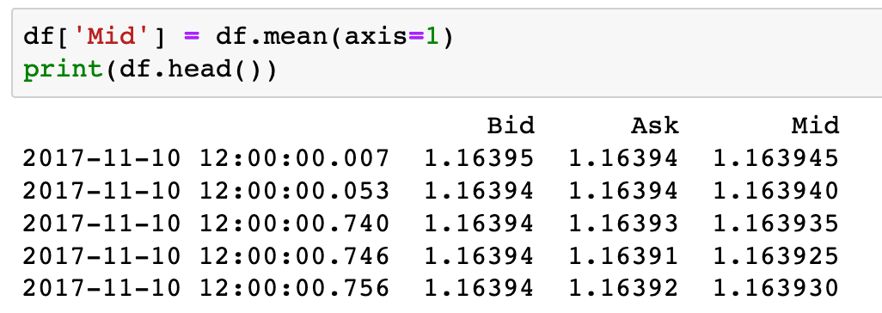

Slide 6
axis=1

Slide 7
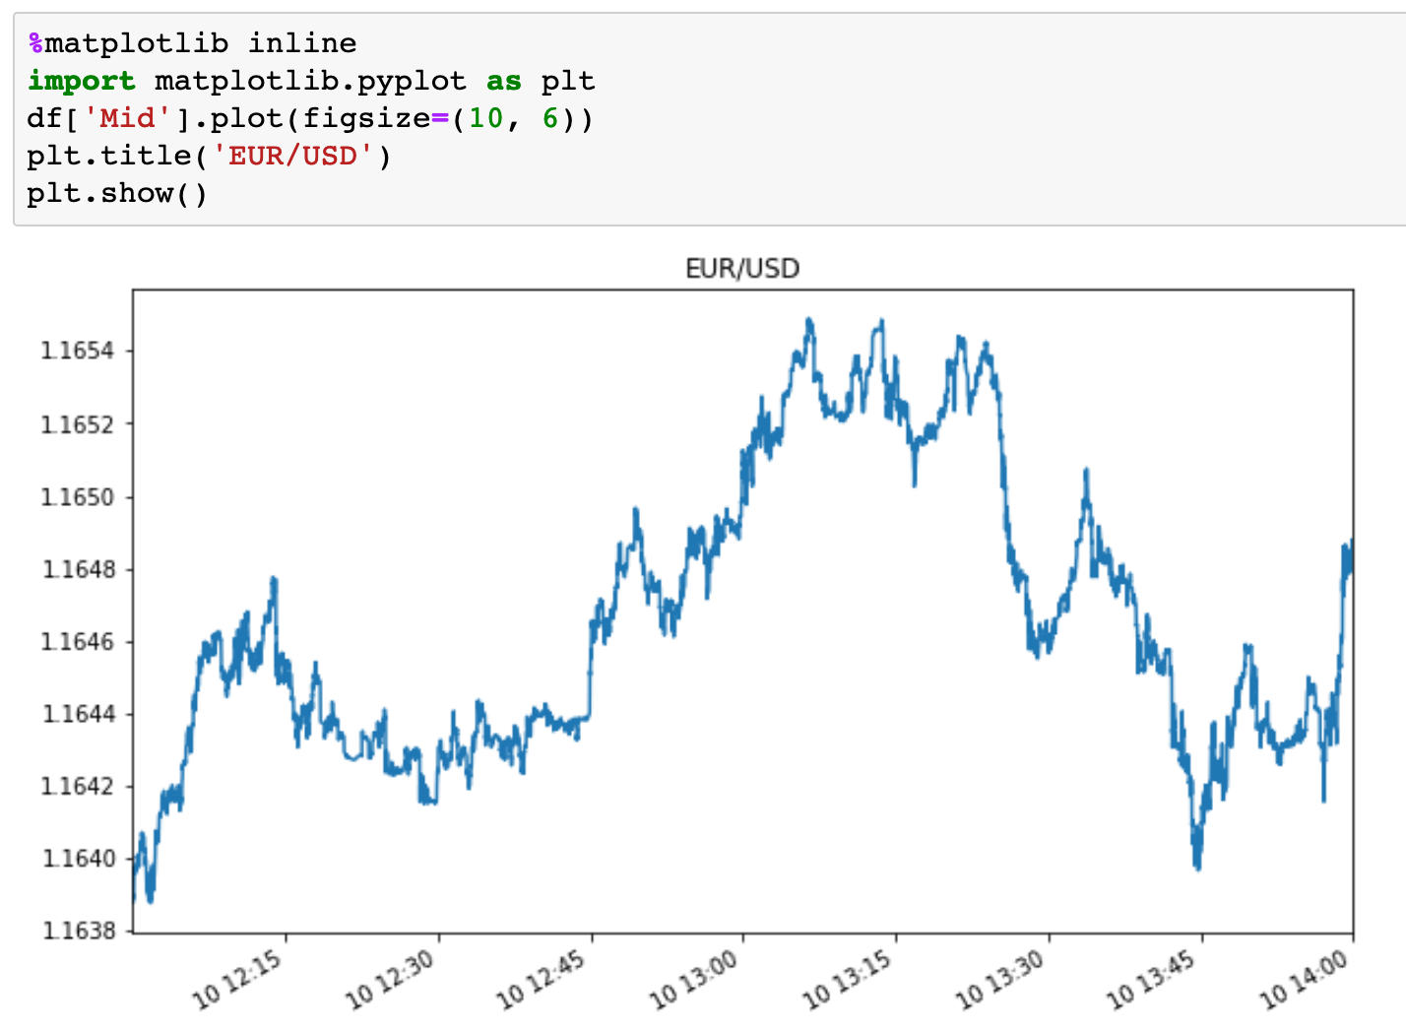

Slide 8
resample method

Slide 9
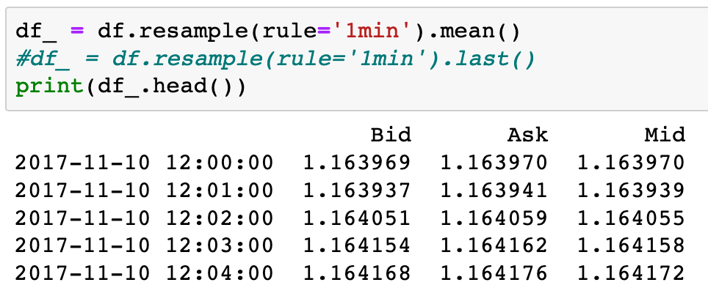

Slide 10


Slide 11
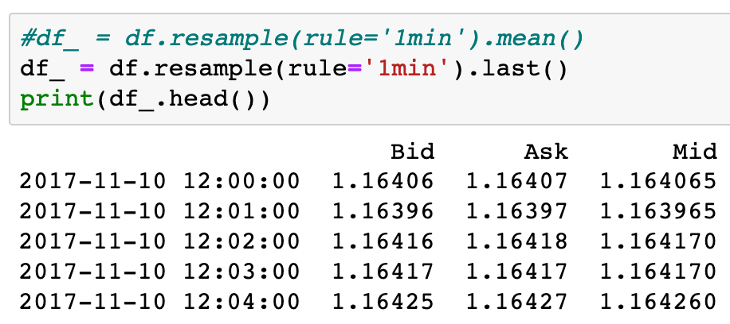

Slide 13
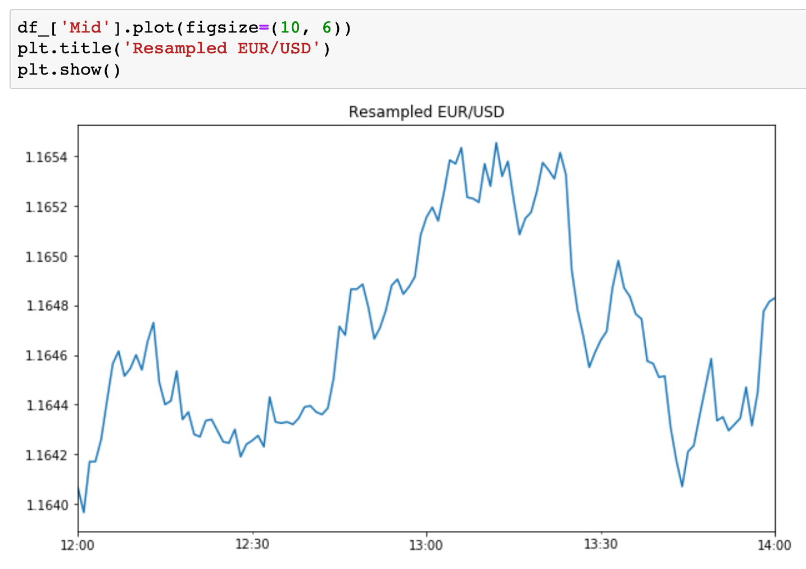

Slide 14
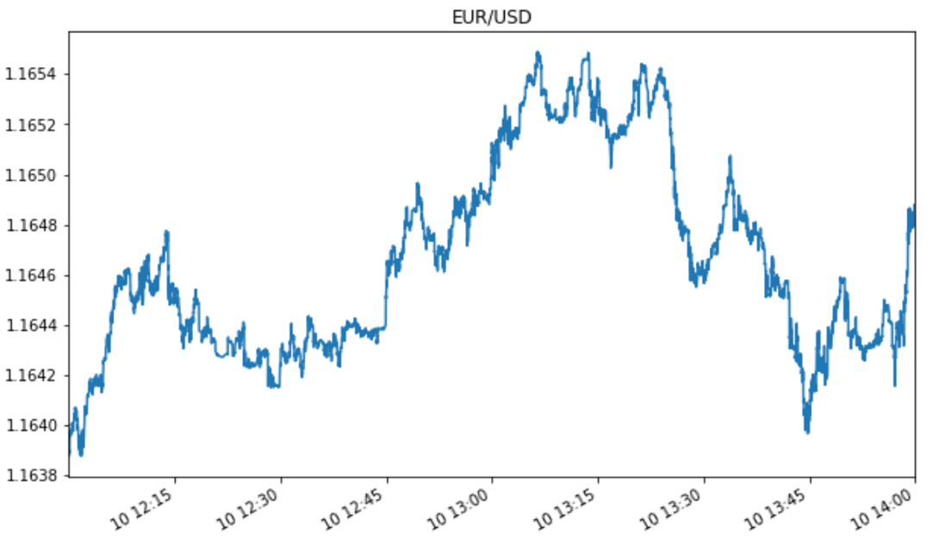

Slide 15
apply method

Slide 16
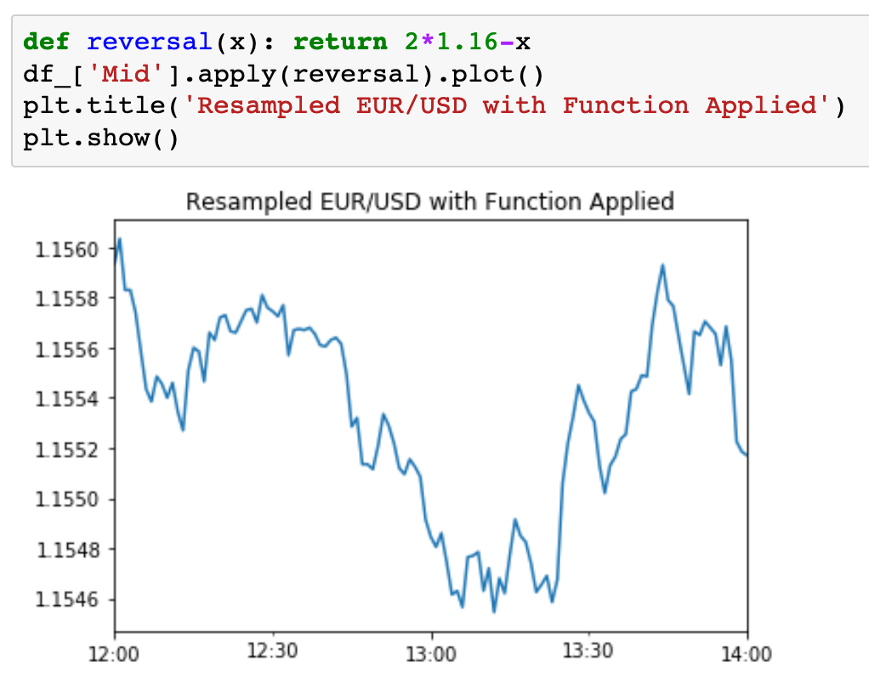

Slide 17
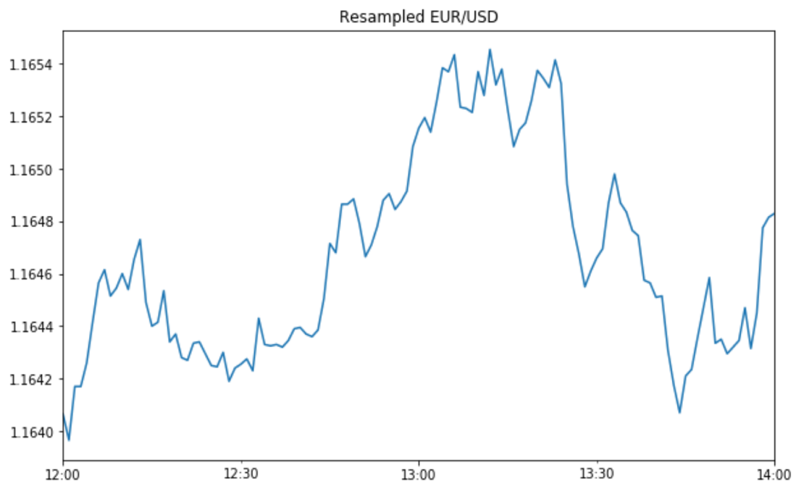

Slide 18
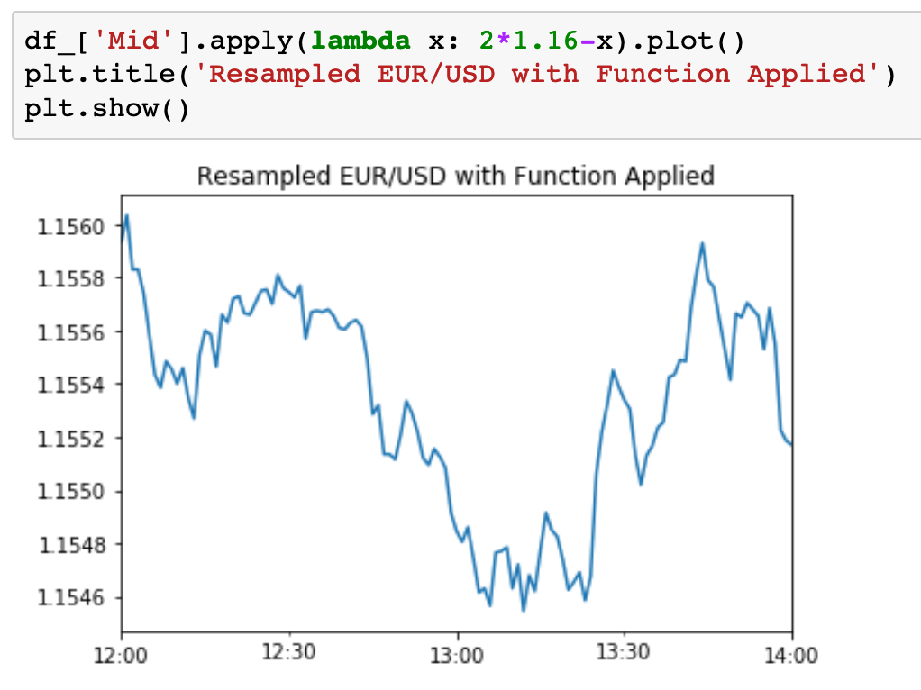

Slide 20
Now
Let’s Play with Code

